Slide 1
Password Manager Using Protection of CIA Traids
Group 1 Soumya kodumuri 11602632
Sai Varun Gadde 11634194
Sai Ram Paidipalli 11596908 Posina Sravani 11643266
Gouthami Gongidi 11647161
Bindu Priya Pannala 11609880 Hasya Reddy Gajjela 11660452

Slide 2
INTRODUCTION
Confidentiality, integrity, and availability are the three primary principles that the CIA triad, a fundamental idea in information security, uses to describe three key concepts. These three guidelines serve as the fundamental tenets of information security and are crucial for safeguarding private data as well as making sure that vital infrastructure and systems continue to be safe and effective.
Organizations may manage the complicated regulatory environment related to information security with the use of compliance management software. Organizations may make sure they are complying with regulatory standards and avoiding penalties by automating compliance management procedures and offering real-time visibility into compliance status. Finally, good risk management techniques may assist businesses in striking a balance between security and operational expenses. Organizations may identify possible hazards and take affordable actions to minimize them by regularly performing risk assessments and creating risk management strategies.

Slide 3
PROBLEM STATEMENT
Many people use numerous online accounts that require login credentials such as usernames and passwords. Keeping track of these login credentials can be difficult, especially when the passwords are complex and unique for each account. Writing down passwords or using the same password for multiple accounts is not secure and can lead to identity theft. A solution is needed to securely store and manage login credentials for multiple accounts in a convenient and efficient manner. A password manager should be designed to provide a secure and centralized storage for login credentials, with strong encryption.

Slide 4
So, How does this Password Manager fall under CIA Traids???

Slide 5
Yes, a password manager using a cipher would fall under the principles of confidentiality, integrity, and availability. 1)Confidentiality: The password manager is responsible for keeping the passwords of users confidential and secure. Using a cipher to encrypt the passwords helps to achieve this goal by ensuring that only authorized users can access the passwords. 2)Integrity: The password manager must ensure that the passwords stored in it are accurate and have not been tampered with. By using a cipher, the passwords are protected from unauthorized modification and manipulation. 3)Availability: The password manager should be available to authorized users whenever they need it. Using a cipher to encrypt the passwords helps ensure that the passwords are accessible only to authorized users and are protected from unauthorized access, which could lead to unavailability.

Slide 6
METHOD
Password Manager is based on python 3. It uses PyCryptodome, PBKDF2 and pickle libraries for its functioning. At first the User is asked to enter Master Password for verification of Identity. Then user chooses the desired operation from the menu. Then User is asked to Enter details as required for the operation. And then the Appropriate Operation is performed. And at last output is printed for the user.

Slide 7
WHAT IS A CIPHER?
A cipher is a method of encrypting or secret writing that transforms plain text into coded or disguised form to protect information from unauuthorized access to sensitive information. It has been used throughout history and is implemented in modern cryptography as algorithms in computer software and hardware.
AES-256-GCM is a type of cipher that combines the AES algorithm with the GCM mode of operation to provide authenticated encryption with a 256-bit key. It is widely used in secure communications, cloud storage, and data protection, and is regarded as a robust and secure encryption method

Slide 8
A key is set of information usually a string of numbers or letters that are stored in a file, which is used by cipher as a dictionary to convert plaintext to ciphertext and vice versa. We are using a symmetric key for both encrypting and decrypting the password and is not shared with anyone else.
WHAT IS A KEY

Slide 9
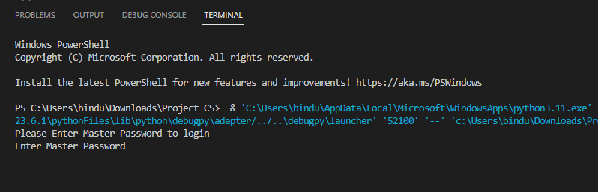
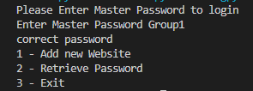
RESULT

Slide 10
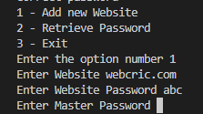

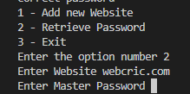

Slide 11
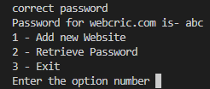
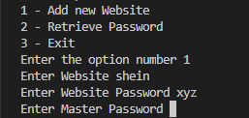
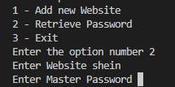

Slide 12
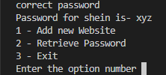



Slide 13

VALIDATION AND ASSESSMENTS
The Process of assessing or testing the performance of a model. It involves checking that the results produced by the model are consistent with the expected outcomes and that they meet the requirements and specifications.
Here , We are validating our data as by giving invalid credentials as shown in below screenshot.

Slide 14
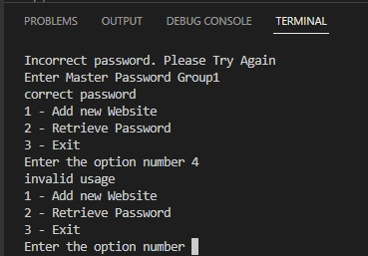
VALIDATION AND ASSESSMENTS
Here , We are validating the data and the below screenshot shows the violation of integrity as we are trying to access the data, which was not included in the system.

Slide 15
VALIDATION AND ASSESSMENTS
In term of confidentiality we are protecting the private information from third party. To ensure confidentiality, multiple security measures have been implemented, including access controls, encryption, and data loss prevention technologies. The protection of Information using password management is vital for preserving the privacy and security of individuals and organizations and for safeguarding against potential threats to the CIA triad.
In terms of Integrity we make sure that the data is stored continuously and safeguarding of data against unauthorized modification or deletion . While the data's accuracy, consistency, and completeness have been ensured, along with its integrity, meaning that it is free from any tampering by unauthorized access. By using password management and access controls, is necessary to achieve data integrity.
In terms of Availability we have maintained the capacity of critical resources and systems to remain operational and accessible to authorized users. We have ensured that systems are available for use when needed and protected against attack using password management. Access controls are necessary to ensure availability

Slide 16
CONCLUSION AND FUTURE WORK
In conclusion, the CIA triad is a fundamental idea in information security that identifies three key principles: confidentiality, integrity, and availability. These concepts are crucial for protecting crucial assets and systems.
Although these ideas are simple in theory, there are several difficulties and obstacles related to efficiently putting them into practice.
PBKDF2 algorithm is widely used in password-based encryption, key derivation, and authentication schemes. It is a strong algorithm that provides a high level of security when used with a sufficiently large iteration count and a random salt (random value).

Slide 17
CONCLUSION AND FUTURE WORK
Password managers are particularly useful in the future work, as more and more businesses move their operations online and employees use multiple accounts and applications. Here are some ways that password managers can be useful in the future of work:
Advanced security features: Many password managers offer advanced security features such as two-factor authentication and biometric authentication, further enhancing the security of employee accounts.
Multi-device support: Password managers can sync your passwords across multiple devices, so you can access your accounts from your phone, tablet, or computer without having to remember your login information.
Developing a mobile app: building a mobile app that allows users to access there securily on there mobile devices.

Slide 18
Thank you

